Slide 1
FUZZY LOGIC & CONTEXT AWARE DECISIONS
August 2025
Notes:
Beyond Traditional Risk Rankings. Next Gen Risk Analysis

Slide 2

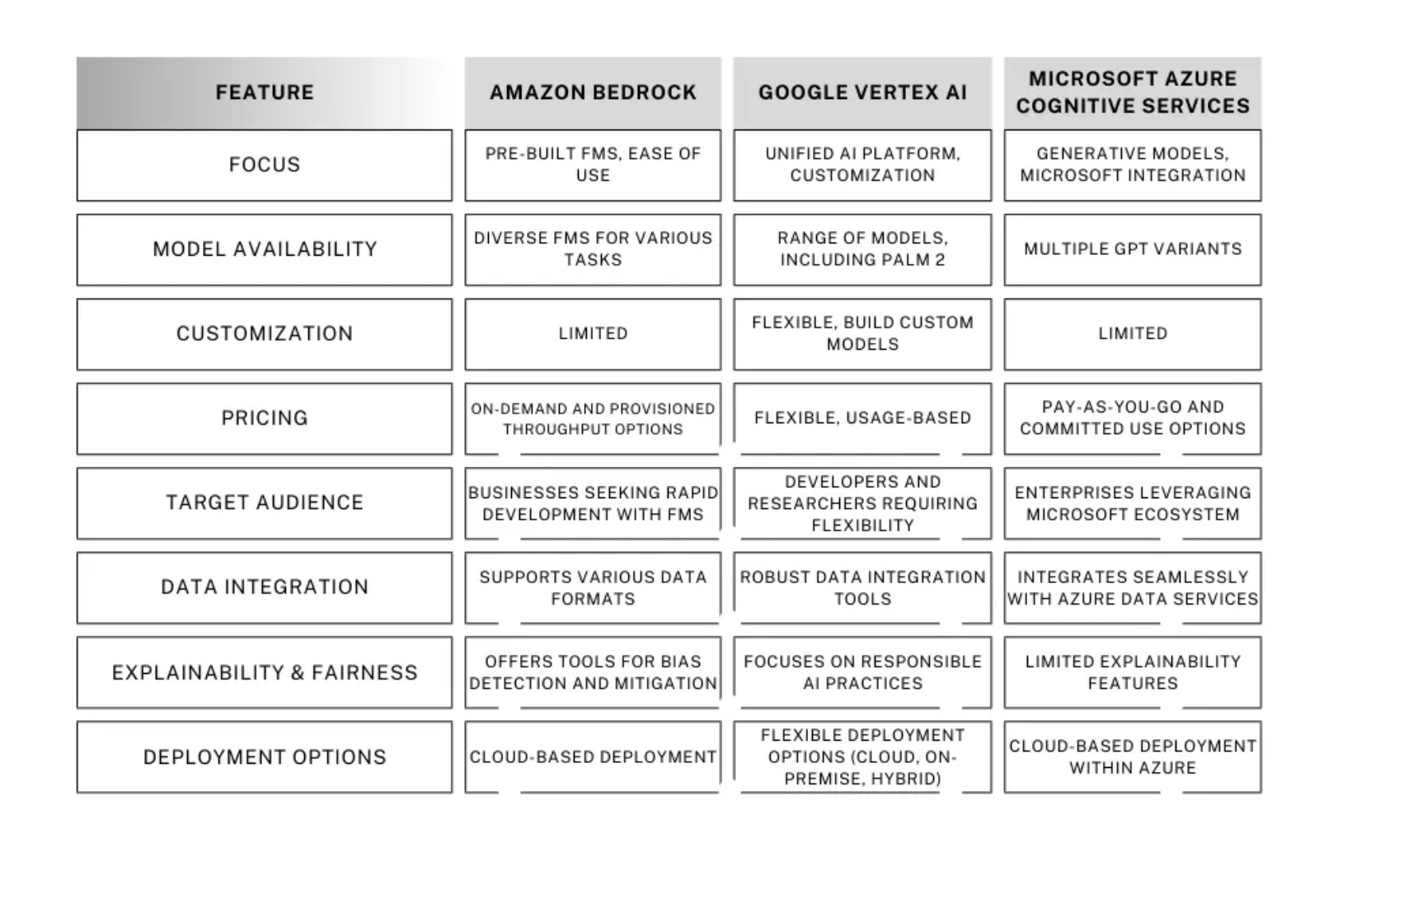
Generative AI Platforms
Notes:
Source https://medium.com/@kaushikvikas/amazon-bedrock-vs-8a58059026da
Similar concepts with different platforms details today on Azure

Slide 3
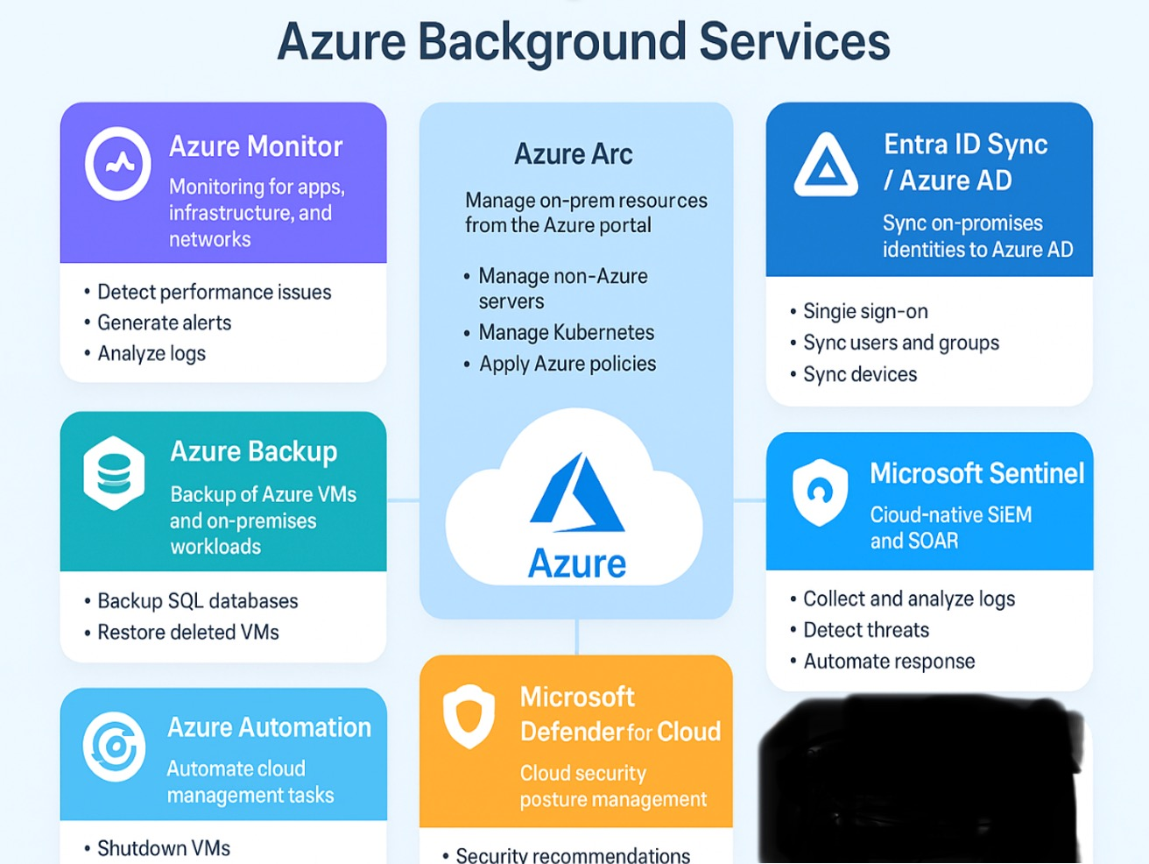
AZURE BACKGROUND SERVICES
Notes:
Background services are the foundation layer, azure agents are the data collectors and fuzzy logic is the decision layer

Slide 4
Azure Monitor
Azure Monitor Data Life Cycle Flow
Visualization
Azure Portal Dashboards – Customizable monitoring dashboards
Workbooks – Interactive reports for advanced analysis
Grafana / Power BI integration – For external visualization
Notes:
Visualization into identity signals and user activity turning raw logs into context for smarter access decisions

Slide 5
Azure Monitor
Azure Monitor Data Life Cycle Flow
Alerting & Automation
Alerts – Rules can trigger when thresholds are crossed
Action Groups – Define how alerts notify (Email, SMS, Teams, Webhooks, ITSM tools like ServiceNow)
Automation – Trigger Azure Logic Apps, Functions, or Runbooks for auto-remediation (e.g., restart a VM when it goes down)
Notes:
Azure Logic Apps automate IAM workflows like provisioning, approvals and access reviews for consistent governance

Slide 6
Azure Arc
Azure Arc is a hybrid and multicloud management service from Microsoft.
It extends Azure’s management, governance, and security capabilities to non-Azure environments, such as:
On-premises servers and VMs
VMware clusters
Kubernetes clusters
Edge devices
Other public clouds (AWS, GCP, etc.)
Azure Arc brings Azure control plane anywhere.
Notes:
Extends IAM governance and access policies to servers, apps and resources outside of Azure

Slide 7
Azure Arc
Management & Governance
Azure Arc extends Azure services and policies to hybrid/multi-cloud environments:
Policy & Compliance – Apply Azure Policy across on-prem and cloud resources.
Access Control – Use Azure AD-based RBAC for identity and permissions.
Tagging & Inventory – Organize resources with metadata for better governance.
Automation & DevOps
Supports ARM templates, Bicep, Terraform, and GitOps for resource management.
CI/CD pipelines can deploy workloads consistently across Azure + Arc-enabled environments.
Notes:
Arc bridges IAM and DevOps by extended Azure policies, RBAC & GitOpp workflows across hybrid environments

Slide 8
Entra ID Sync (Azure AD Connect)
Key Services of Entra ID / Entra ID Sync
1. Identity Synchronization
2. Single Sign-On (SSO)
3. Self Service Features
4. Conditional Access & Security
5. Monitoring & Health
6. Application Integration
Provides SSO and provisioning to thousands of SaaS applications from the Azure AD App Gallery.
Supports SCIM-based provisioning for third-party apps.
Notes:
Entra ID Sync has come a long way not just syncing on prem to cloud but lifecycle workflows, access governance and identity security

Slide 9
Microsoft Sentinel
Microsoft Sentinel is a cloud-native SIEM (Security Information and Event Management) and SOAR (Security Orchestration, Automation, and Response) solution.
It collects data across an organization (users, apps, servers, devices, and cloud workloads), detects threats, and responds with automation.
Services of Microsoft Sentinel
Data Collection from Azure, on-prem, and third-party sources
Threat Detection using rules, threat intel, and AI
Behavior Analytics (UEBA) for anomaly detection
Threat Hunting & Investigation with KQL and investigation graphs
Incident Management (alerts grouped into incidents)
Automation & Response (SOAR) with playbooks
Dashboards & Visualization (workbooks, Power BI)
Integration with Microsoft and third-party security tools
Compliance & Reporting for governance needs
Notes:
Cloud native security monitoring and insights by analyzing signals from and across IAM infrastructure

Slide 10
Azure Automation
Azure Automation is a cloud-based automation and configuration service.
It helps manage Azure and non-Azure (on-premises or other cloud) resources through:
  Process automation
  Configuration management
  Update management
  Inventory and change tracking
  It reduces manual tasks, ensures consistency, and improves operational efficiency.
Services of Azure Automation
Process Automation → Runbooks for task automation (VM lifecycle, backups, cleanup).
Configuration Management (DSC) → Enforce and maintain desired system state.
Update Management → Centralized patching for Windows/Linux servers.
Change Tracking & Inventory → Track system changes, maintain audit trails.
Hybrid & Integration Capabilities → Hybrid workers, source control, webhooks, RBAC.
Notes:
More on policy enforcement across hybrid environments

Slide 11
Microsoft Defender for Cloud
Microsoft Defender for Cloud is a cloud-native security posture management (CSPM) and cloud workload protection platform (CWPP).
It helps protect Azure, hybrid, and multi-cloud environments (AWS, GCP) by providing:
Security posture management
Threat protection for workloads
Compliance monitoring
Services of Microsoft Defender for Cloud
Security Posture Management (CSPM) → Secure Score, recommendations, compliance tracking.
Workload Protection (CWPP) → Threat protection for VMs, containers, storage, databases, key vault, DNS, etc.
Defender Plans → Specialized defenses for each type of resource.
Threat Detection → Real-time monitoring, alerts, and integration with Sentinel.
Regulatory Compliance → Framework mapping, dashboards, and reports.
Vulnerability Management → Scanning, assessments, and prioritized remediation.
Automation & Integration → Policy enforcement, playbooks, and integration with Microsoft security ecosystem.
Notes:
Protects identities and access by detecting threats and enforcing security

Slide 12
Azure Backup
Azure Backup is a cloud-based backup and recovery service that helps protect data across on-premises, Azure, and hybrid environments.
It provides secure, scalable, and cost-effective solutions for backing up files, workloads, and entire systems.
Services of Azure Backup
VM Backup – Protects Azure VMs with full/restore capabilities.
On-Prem Backup (MARS Agent) – File/folder/system state backup to Azure.
Workload Backup (MABS/DPM) – SQL, Exchange, SharePoint, Hyper-V, VMware.
File Share Backup – Protects Azure Files.
Disk Backup – Snapshot-based managed disk backup.
Database Backup – SQL, PostgreSQL, SAP HANA.
Blob Backup – Backup and soft delete protection for blob storage.
Long-Term Retention – Keep backups for years.
Security Features – Encryption, soft delete, MUA.
Monitoring & Reporting – Backup status, alerts, dashboards.
Notes:
Zero trust is not just about protecting identities also about ensuring rapid recovery if identities or credentials are compromised

Slide 13
Microsoft Secure Score
Microsoft Secure Score is a security analytics and measurement tool in Microsoft 365 Defender and Microsoft Entra admin center.
It helps organizations:
Measure their security posture
Get recommendations to reduce risk
Track improvements over time
It assigns a numerical score (0–100% or higher, depending on enabled services) based on security controls implemented.
Services of Microsoft Secure Score
Posture Measurement → Assigns a security score to your org.
Recommendations & Actions → Suggests security improvements.
Multi-Service Integration → Covers Entra ID, Defender (Endpoint/Office/Cloud Apps), Teams, SharePoint, etc.
Improvement Tracking → Monitors progress over time.
Benchmarking → Compare with industry and peers.
Reporting & APIs → Dashboards, Power BI, Graph API.
Licensing Integration → Works across Microsoft 365 and security tools.

Slide 14
Microsoft Security & Compliance
Microsoft Security & Compliance refers to the set of tools, services, and solutions from Microsoft that help organizations protect data, manage risk, enforce security policies, and meet regulatory requirements across their digital environment.
It’s Microsoft’s ecosystem to secure identities, endpoints, applications, cloud workloads, and data while ensuring compliance with legal, regulatory, and organizational policies.
Why It Matters
Ensures organizational data and resources are secure.
Helps avoid regulatory fines and legal issues.
Improves visibility into risks and overall security posture.
Provides tools for proactive threat detection and response.
Microsoft Products Involved
Entra / Azure AD → Identity & access management
Microsoft Defender Suite → Threat protection (Endpoints, Office 365, Identity, Cloud Apps)
Microsoft Purview → Compliance, data governance, risk management
Microsoft Sentinel → SIEM + SOAR, threat monitoring & response
Intune / Endpoint Manager → Device & app security
Notes:
Risk is not static but can run this anytime but back to fuzzy logic and topic here is it really relect what is happening now

Slide 15
Microsoft Next-Generation Risk Analysis
Microsoft is advancing risk analysis beyond traditional methods by combining probabilistic models, AI/ML, and simulation techniques to anticipate, evaluate, and mitigate risks in complex systems (cloud, enterprise IT, cybersecurity, and compliance environments).
Fault Tree Analysis (FTA)
A top-down, deductive risk assessment method used to analyze causes of system failures.
Starts with a “top event” (system failure or risk occurrence) and breaks it down into contributing causes using logic gates (AND, OR).
How Microsoft uses it:
To identify potential points of failure in IT systems, cloud infrastructure, or security policies.
Helps model cascading failures, e.g., what combination of misconfigurations, compromised accounts, or missing patches could lead to a breach.
Used in Azure reliability, Defender risk modeling, and compliance simulations.

Slide 16
Microsoft Next-Generation Risk Analysis
Example:
Top event: “Data breach in cloud database”
Sub-events:
  Misconfigured firewall (OR)
  Compromised user credentials (OR)
  Lack of encryption (AND with above)
This gives a visual map of vulnerabilities and their probability of causing the top event.
Graph Neural Networks (GNNs)
A machine learning model designed for graph-structured data (nodes + edges).
Can capture relationships and dependencies in complex networks, such as social networks, organizational IT, or cloud resources.
How Microsoft uses it:
In security and risk analysis to model relationships between:
  Users, devices, and apps (identity graphs)
  Cloud resources and dependencies (network graphs)
  Threat propagation in enterprise systems
Predicts risk propagation through networks using historical incident data.
Enhances anomaly detection, insider threat detection, and cloud risk scoring.

Slide 17
Microsoft Next-Generation Risk Analysis
Example:
Nodes: Users, VMs, storage accounts
Edges: Access relationships, communication flows
GNN predicts which nodes are most likely to be compromised if one node is attacked.
Adversarial Modeling
A technique to simulate attacks and test defenses using intelligent adversary models.
Includes creating “red team” simulations to see how an attacker might exploit weaknesses.
How Microsoft uses it:
In cybersecurity planning for Azure, Microsoft 365, and hybrid environments.
Generates potential attack scenarios to evaluate resilience and prioritize mitigation.
Combines with FTA and GNNs to calculate the probability of attack success and systemic impact.
Example:
Adversarial model simulates a phishing campaign → predicts how compromised accounts could lead to data exfiltration → feeds results into Secure Score or Defender risk models.

Slide 18
Microsoft Next-Generation Risk Analysis
How These Approaches Work Together
Technique | Role in Risk Analysis | Example Use
Fault Tree Analysis | Identify root causes and failure paths | Predict which combination of system failures leads to a cloud breach
Graph Neural Networks | Model relationships & predict risk propagation | Map risky user-device-resource interactions in enterprise networks
Adversarial Modeling | Simulate attacks to test defenses | Red-team style simulation for phishing or ransomware attacks
Integration:
Microsoft combines these techniques to quantify risk, prioritize mitigations, and improve predictive security.
They allow context-aware, data-driven decision-making, moving beyond checklist/compliance-based scoring.

Slide 19
Microsoft Fuzzy Logic – Evaluating Intent
Fuzzy logic is a mathematical approach that allows reasoning with uncertainty, ambiguity, or partial truth, rather than the strict true/false (0 or 1) logic of traditional systems.
In Microsoft security and compliance systems, fuzzy logic is used to evaluate intent—for example, determining whether a user action, login, or data access event is suspicious, risky, or potentially malicious.
Purpose in Evaluating Intent
User behavior is rarely binary: A login from a new location may not always be malicious, but it could indicate risk.
Fuzzy logic allows Microsoft systems to assign degrees of risk or intent (e.g., low, medium, high) instead of just “safe/unsafe.”
Helps improve decision-making in security systems, especially for identity, access, and threat detection

Slide 20
Microsoft Fuzzy Logic – Evaluating Intent
Advantages of Using Fuzzy Logic
Handles uncertainty in user behavior and network activity.
Reduces false positives compared to binary threshold systems.
Enables context-aware decision-making in real time.
Works well with AI/ML and graph-based models to improve predictive security.

Slide 21
Microsoft Azure Background Services for Fuzzy Logic &
Layered Analysis
Key Benefits of Integrating Fuzzy Logic with Layered Analysis
Context-Aware Decisions – Evaluates risk or system state in degrees, not just binary.
Reduced False Positives – Prioritizes truly actionable events.
Proactive Operations – Supports predictive actions based on combined signals from multiple layers.
Automation & Efficiency – Dynamic decisions feed into automated workflows via Azure Automation or Sentinel playbooks.
True Insights – Provides nuanced understanding of system, user, and security behaviors.
Microsoft Azure background services integrate fuzzy logic and layered analysis to make dynamic, context-aware operational and security decisions, moving beyond static thresholds and simple binary alerts.
Notes:
IAM gaps emerge when systems can’t incorporate dynamic signals into access decisions
Map access failures such as excessive privilege turns into identity related breaches
Model relationships between identities, groups, and entitlements, useful for toxic combinations and lateral movement detections
Predict attacker strategies like privilege escalation or service account abuse

